Slide 1
CENTER OF MASS

Slide 2
The Center of Mass
There is a special point in a system or object, called the center of mass, that moves as if all of the mass of the system is concentrated at that point.
The system will move as if an external force were applied to a single particle of mass M located at the center of mass.
  M is the total mass of the system.
This behavior is independent of other motion, such as rotation or vibration, or deformation of the system.
  This is the particle model.

Slide 3
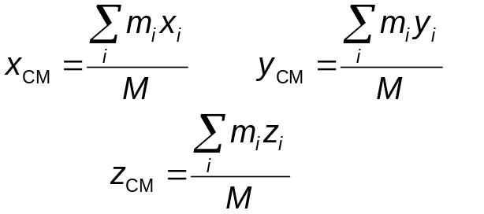
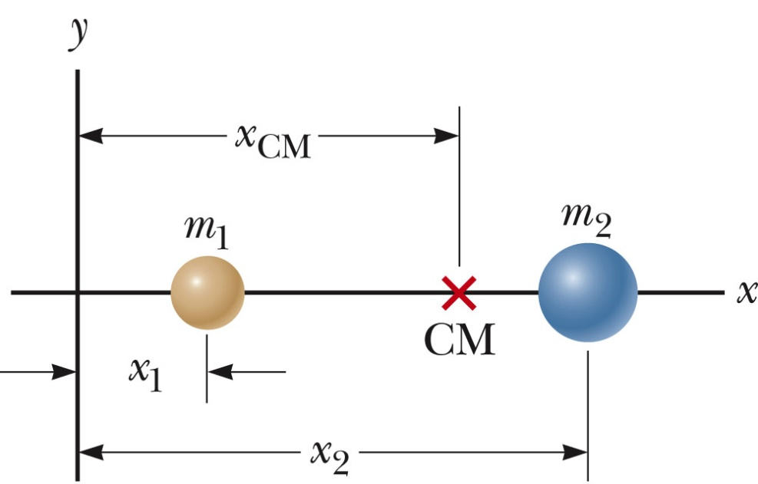
Center of Mass, Coordinates
The coordinates of the center of mass are
  M the active figure to obis the total mass of the system.
    Observe the effect of different masses and positions.

Slide 4
Center of Mass, Symmetric Object
The center of mass of any symmetric object of uniform density lies on an axis of symmetry and on any plane of symmetry.

Slide 5


Center of Gravity
Each small mass element of an extended object is acted upon by the gravitational force.
The net effect of all these forces is equivalent to the effect of a single force acting through a point called the center of gravity.
  If is constant over the mass distribution, the center of gravity coincides with the center of mass.

Slide 6

Newton’s Second Law for a System of Particles
Since the only forces are external, the net external force equals the total mass of the system multiplied by the acceleration of the center of mass:
The center of mass of a system of particles of combined mass M moves like an equivalent particle of mass M would move under the influence of the net external force on the system.

Slide 7
Rocket Propulsion
When ordinary vehicles are propelled, the driving force for the motion is friction.
  The car is modeled as an non-isolated system in terms of momentum.
  An impulse is applied to the car from the roadway, and the result is a change in the momentum of the car.
The operation of a rocket depends upon the law of conservation of linear momentum as applied to an isolated system, where the system is the rocket plus its ejected fuel.
As the rocket moves in free space, its linear momentum changes when some of its mass is ejected in the form of exhaust gases.
  Because the gases are given momentum when they are ejected out of the engine, the rocket receives a compensating momentum in the opposite direction.
  In free space, the center of mass of the system moves uniformly.

Slide 8
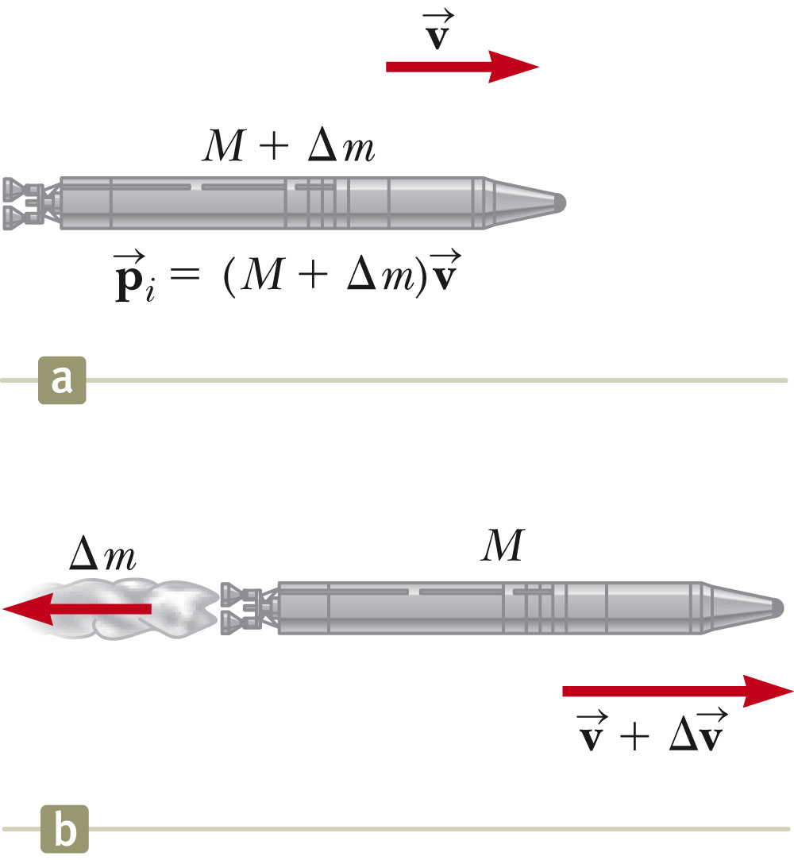

Rocket Propulsion, 2
The initial mass of the rocket plus all its fuel is M + Δm at time t_{i} and speed v.
The initial momentum of the system is
At some time t + Δt, the rocket’s mass has been reduced to M and an amount of fuel, Δm has been ejected.
The rocket’s speed has increased by Δv.

Slide 9
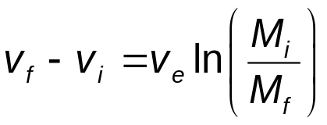
Rocket Propulsion, 3
The basic equation for rocket propulsion is
The increase in rocket speed is proportional to the speed of the escape gases (v_{e}).
  So, the exhaust speed should be very high.
The increase in rocket speed is also proportional to the natural log of the ratio M_{i}/M_{f.}
  So, the ratio should be as high as possible, meaning the mass of the rocket should be as small as possible and it should carry as much fuel as possible.

Slide 10
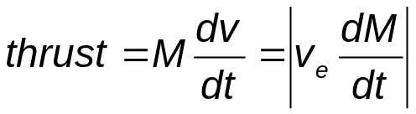
Thrust
The thrust on the rocket is the force exerted on it by the ejected exhaust gases.
The thrust increases as the exhaust speed increases.
The thrust increases as the rate of change of mass increases.
  The rate of change of the mass is called the burn rate.

